Slide 1

Modelling a supercomputer with the model
Tuan V. Dinh, Lachlan Andrew and Yoni Nazarathy
Australia and New Zealand Applied Probability Workshop

Slide 2




Supercomputer clusters
large scale simulation: climate, genome, astronomy, etc.
foundation of cloud computing
EXASCALE COMPUTING
MORE COMPUTING POWER DESIRED
BIG DATA
Electricity bills
Heat – thermal management
Investment – cooling systems,
hardware, etc.

Slide 3
Power proportionality
Power
reality
60% peak
ideal
Swinburne Supercomputer
single server⁽¹⁾
Load
idle server
~ 60% peak power
challenges:
switching cost
(setup, wear-and-tear), performance impacts ?
turn off
idle servers
(1) Bassoro, “The case for energy proportional”, 2007.

Slide 4
An energy saving framework
CONTROL FRAMEWORK
arrival characteristics ?
historical implications ?
system congestion
model
number of active servers needed ?
ongoing
system states ?
job elapsed times ?
Objective:
performance penalty
min ( )
energy
+
switching
+

Slide 5

Congestion model
CONTROL FRAMEWORK
arrival characteristics ?
historical implications ?
number of active servers needed ?
ongoing
system states ?
job elapsed times ?
Objective:
performance penalty
min ( )
energy
+
switching
+

Slide 6



Congestion model -
batch Poisson, rate function
1
2
i.i.d service time
with c.d.f
batch size distribution
3
…
jobs arrive in “batch” manner,
i.e within seconds, from same user
system mostly under-utilized,
using infinite server approximation
WHY ?
substantial daily variations

Slide 7








Discrete-time cost
{jobs arriving in (t,t+k],
still around at t+k}
{jobs arriving before t, still around at t+k}
: current running jobs
t
t +k
T+t
time
C(k) = n(k) + |n(k) – n(k-1)| +
C₁(k):energy
C₂(k):switching
C₃(k):performance penalty

Slide 8
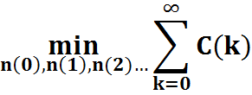
Optimization formulation
C(k) = n(k) + |n(k) – n(k-1)|+
C₁(k):energy
C₂(k):switching
C₃(k):performance penalty
solving (*): load estimation
in far future.
(*)
the system can feedback the ACTUAL load U(s) for s < k

Slide 9
A Model Predictive Control framework
arrival characteristics ?
CONTROL FRAMEWORK
historical implications ?
MPC
number of active servers needed ?
ongoing
system states ?
job elapsed times ?
Objective:
performance penalty
min ( )
energy
+
switching
+

Slide 10
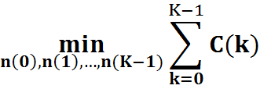
Model Predictive Control execution
Solve (**), obtain {n*(0), n*(1),…}.ONLY “execute” n*(0).
Solve (**), obtain {n*(0), n*(1),…}.ONLY “execute” n*(0).
T
T
t
T+t
time
T+t+1
t +1
know how many jobs actually arrived in (t,t+1]
Limited look-ahead
(**)
less sensitive to load estimation accuracy
Use “on-going” information

Slide 11


Solving the optimization problem
C(k) = n(k) + |n(k) – n(k-1)|+
C₁(k):energy
C₂(k):switching
C₃(k):performance penalty
{ n(k) + |u(k)| } (***)
Normal approximation
s.t: ,
k =0,1…,K-1
k =0,1…,K-1
solved numerically using LP

Slide 12



X(k): new arrivals
{jobs arriving in (t,t+k],
still around at t+k}
[Carrillo,89]: is a compound Poisson RV, with batch rate:
, where s = (k+1/2)Δ; Δ: slot-time.
N ~ Poisson( )
b_{i}: i.i.d batch size, mean and variance
even if the arrival process is NOT Poisson, [Whitt,99].

Slide 13



U(k): existing jobs
{jobs arriving before t, still around at t+k}
[Carrillo,91]: is a binomial RV, with parameters:
and , where s = (k+1/2)Δ; Δ: slot-time.
Hence:
one can use job elapsed runtimes to calculate [Whitt,99]

Slide 14
Summary of analytical framework
arrival characteristics ?
CONTROL FRAMEWORK
MPC
historical implications ?
number of active servers needed ?
LP optimization
ongoing
system states ?
Normal approximation
job elapsed times ?
Objective:
performance penalty
min ( )
energy
+
switching
+

Slide 15
Numerical evaluation
Swinburne supercomputer
logs
system states
supercomputer
simulator
cost performance
CONTROLLER
control decision

Slide 16
Scheme 1: All up (no turn off)
Swinburne supercomputer
logs
system states
supercomputer
simulator
cost performance
NO CONTROL
control decision

Slide 17
Scheme 2: t_{wait} heuristic
Swinburne supercomputer
logs
system states
supercomputer
simulator
t_{wait} heuristic
cost performance
control decision
Server idle for t_{wait}
=> turn OFF

Slide 18
Scheme 3: predictive control
Swinburne supercomputer
logs
system states
supercomputer
simulator
MPC
cost performance
control decision
estimated from historical data

Slide 19
S.3: rate function
arrivals
use daily periodic rates
2010
2011
rate
time of day

Slide 20
S.3: service time & batch size
G: service time
[Lublin et al.,2003]:
Hyper-Gamma, Log-uniform
c.d.f
Empirical
(2010)
[Li et al.,2005]:
Log Normal, Weibull
Gamma
X: batch size
(2010)
time(sec)
c.d.f
Our approximations only concern MEAN and VARIANCE of X
size(CPU)

Slide 21
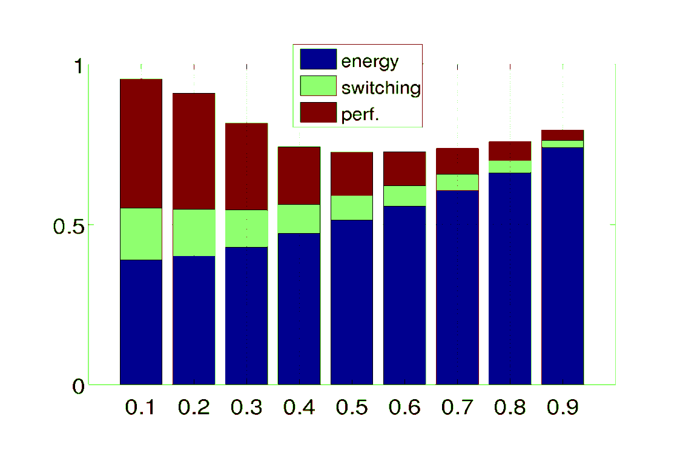

S.3: cost performance
normalised cost
ε ~ service availability
Cost 1 = total cost when there is NO CONTROL (energy only)
Simulation period: 1 year

Slide 22
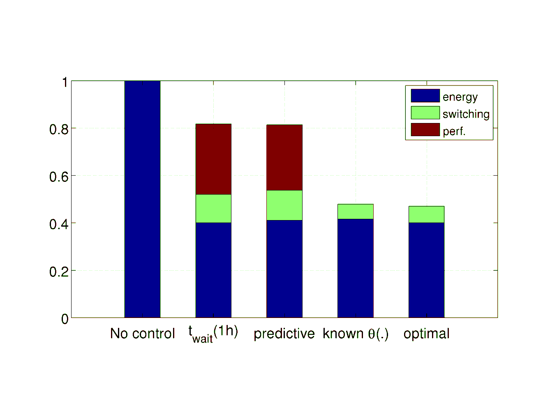

Cost performance: all schemes
consider predictive settings (S.3) whose demand penalty cost is the same as t_{wait} heuristic (S.2)
still > 20% to gain
S.1
S.2
S.3,
ε = 0.58
“offline”
optimal cost
[Lu et al., 12].
No perf. penalty
after all, model is to estimate θ(k)s.

Slide 23
Remarks and considerations
1. Room for improvement: ~20% to gain!
[Dinh,Andrew and Branch,CCgrid13]
rate function
not accurate
2.Examining
our estimations ?
Use job elapsed times
Normal
approximation ?
3. Fundamental bound on what to achieve given uncertainty ?

Slide 24
Thank you
arrival characteristics ?
CONTROL FRAMEWORK
MPC
historical implications ?
number of active servers needed ?
LP optimization
Normal approximation
ongoing
system states ?
job elapsed times ?
Objective:
performance penalty
min ( )
energy
+
switching
+

Slide 25
The objective cost
CONTROL FRAMEWORK
arrival characteristics ?
historical implications ?
number of active servers needed ?
ongoing
system states ?
job elapsed times ?
Objective:
performance penalty
min ( )
energy
+
switching
+

